Slide 1
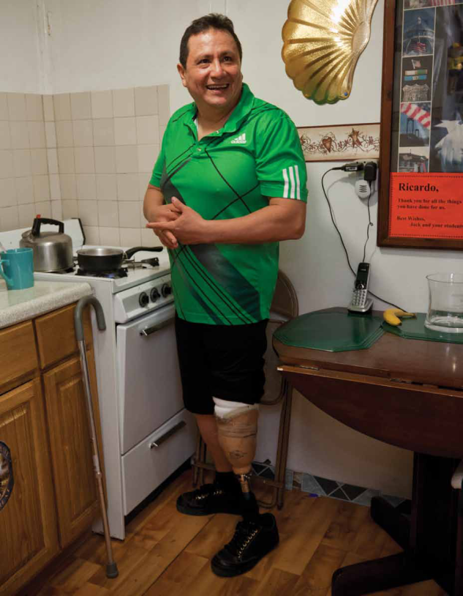
Amerigroup Kansas, Inc.

Slide 2
How we support KanCare members
Person-centered, individualized care management
Focus on helping our members meet their health and wellness goals
Support members to advocate for themselves
Look for innovative ways to collaborate with members, service providers and community resources
Long-term, trusting relationships with community partners

Slide 3
Amerigroup service coordination
We have dedicated service coordinators responsible for:
Involving members in care and service decisions
Resolving issues quickly
Completing comprehensive health assessments
Helping members with referrals
Linking members to community services and other natural supports to help them meet their goals
Helping members schedule appointments
Following up with members after emergency room visits and inpatient stays
Assisting members with inpatient admissions
Coordinating transitional care and services

Slide 4
Amerigroup case management and service coordination
Our individualized care management and service coordination includes:
Long-Term Services and Supports (LTSS) – TBI; TA; FE; I/DD; PD
Behavioral Health Complex Case Management – SED, AU; Serious Mental Illness; Substance Use Disorder
Physical Health Complex Case Management – OB, Pediatrics and Adult

Slide 5
Long-term services and supports (LTSS)
Complete a comprehensive needs assessment and person-centered service plan with the member
Understand the member’s overall health and wellness goals and help them connect with natural supports to help them reach their goals
Help members understand any additional services available to them in their community and help them access those services
Support members’ physical, emotional and social goals by monitoring quality and consistency in service delivery and help resolve gaps as needed
Help members understand how they can help themselves remain healthy

Slide 6
Behavioral health care
Inform members about their illness or condition and engage them in their care plans
Facilitate an internal interdisciplinary approach to coordinate care and services between multiple providers and pharmacies to make sure the right care and services are in place
Connect members with community resources and supports
Recommend mental health, substance use and wellness services
Coordinate with physical health care managers and LTSS staff to provide behavioral health expertise

Slide 7
Physical health case management
Our case managers:
Help members take control of their health care and get the most from their benefits
Assess, plan, coordinate and evaluate services to meet members’ health needs
Develop member-centered goals for optimal health and wellness
Focus on self-advocacy – help members manage their health needs through education and support

Slide 8
Discussion Topic
What is Integrated Care?

Slide 9
Connecting with Amerigroup
Member Services 1-800-600-4441
Amerigroup On Call 1-866-864-2544
Disease Management 1-888-830-4300
Service Coordination 1-877-434-7579, ext. 50103
Vision Care – Ocular Benefits 1-855-866-2623
Dental Benefits – Scion Dental 1-855-866-2627
Transportation – Access2Care 1-855-345-6943
TTY/TDD 711
Member Website www.myamerigroup.com/KS

Slide 10
Questions?

