Slide 1
Selecting & Changing MCOs

Slide 2
KanCare is the program through which the State of Kansas administers Medicaid
Launched in January, 2013
Delivering whole-person, integrated care to approximately 430,000 people across the state
The KanCare program is a managed care program

Slide 3
KanCare Health Plans
MCOs
Kansas has contracted with three health plans, or managed care organizations (MCOs)
These MCOs are required to coordinate all of the different types of care a consumer receives.
Notes:
KanCare Services include:
physical health services such as doctor appointments and hospital visits
nursing facility care
behavioral health services
pharmacy
dental and vision care
transportation

Slide 4
2013
All pre-2013 Medicaid services are now provided through theses three Managed Care Organizations (MCOs).
In addition, the three MCOs offer new, “Extra” or “Value Added Services.”
All the services offered through the State’s Home and Community Based Services (HCBS) waivers are also a part of KanCare.

Slide 5
Choosing the Right MCO
When a consumer is choosing the best plan for them:
Check with each MCO to see providers in their networks.
Find out which doctors, hospitals, pharmacies, or other providers you may use in each network.
Review the “Extra” or “Value Added Services” offered by each MCO.
These “extra services” are not the same for each MCO.
Notes:
The consumer should ask himself/herself:
Does my favorite physician (or other provider) participate in the network for this MCO?
Which MCO’s “extra services” fit my needs best?

Slide 6
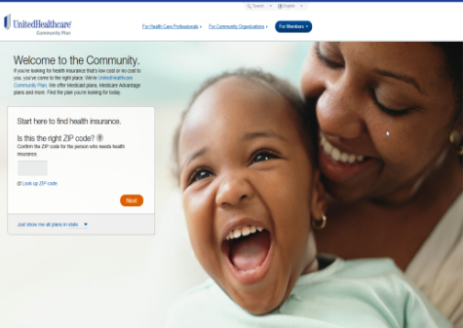
Where to find out which providers are in each MCO’s network:
Amerigroup (1-800-600-4441) www.myamerigroup.com/ks
Sunflower Health Plan (1-877-644-4623) www.sunflowerhealthplan.com
UnitedHealthcare Community Plan
(1-877-542-9238) www.uhccommunityplan.com

Slide 7
Where to View the “Extra Services”
“Health Plan Highlights” is available on the KanCare Website: http://www.kancare.ks.gov/consumers/benefits-services

Slide 8
Where to View these “Value Added Services”
On KanCare’s Benefits & Services webpage, there is an interactive chart that shows the different services offered by each MCO: http://www.kancare.ks.gov/consumers/benefits-services
Just click on each item to see what each MCO offers, regarding that service/benefit.
Notes:
How to access this “Extra Services” chart online:
Google: www.kancare.ks.gov
Click on the “Benefits & Services” link
Scroll down the page until you see the “Health Plan Highlights” chart.

Slide 9
Investigate the services that matter most to you:

Slide 11
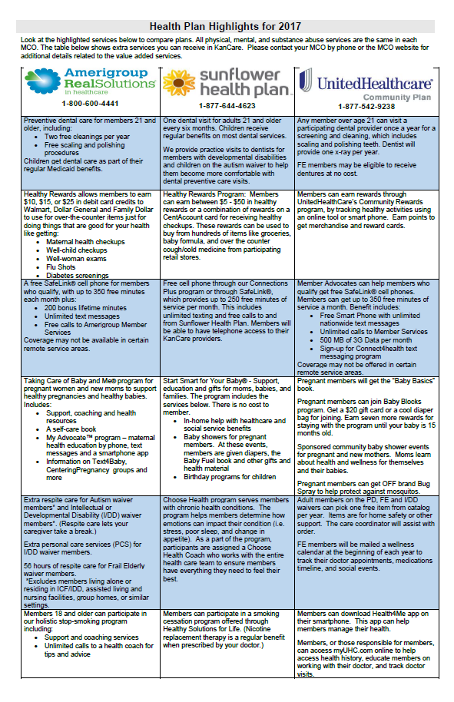
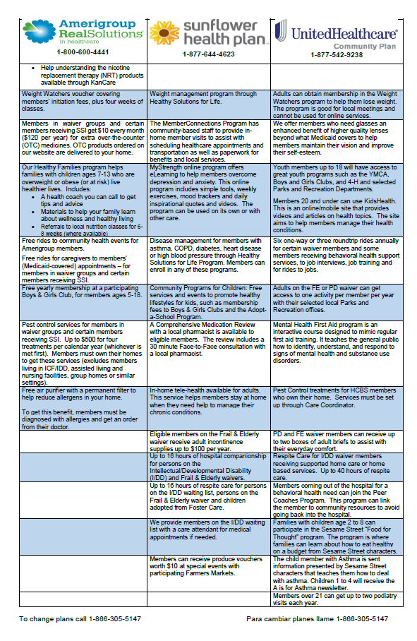
Where to View these “Value Added Services”
There is also a “Health Plan Highlights” chart included in the paper Medicaid Applications packets.
This printable chart is also available on the KanCare Website: http://www.kancare.ks.gov/consumers/benefits-services
Notes:
How to access this “Extra Services” chart online:
Google: www.kancare.ks.gov
Click on the “Benefits & Services” link
Scroll down the page until you see the “Health Plan Highlights” chart.

Slide 12
Different Ways to Notify KanCare which MCO you Prefer
Check the preferred MCO box at the end of the KanCare application.
Mail the KanCare Enrollment Form that you receive in your enrollment packet.
Call the Enrollment Center at 1-866-305-5147
(TDD/TTY 1-800-766-3777)
Enroll online: https://www.kmap-state-ks.us/hcp/member

Slide 13
Selecting an MCO
MCO Selection at Initial Application:
Every consumer has the option to enroll in the MCO of their choice. If you do not make a selection, you will be automatically assigned and enrolled into an MCO.
If you do not like their assignment, you have until the Choice Period End Date on the enrollment form to change plans. This Choice Period End Date is 90 days from initial enrollment.
If you choose not to change MCOs by that date, the next time you are able to change is during their Annual Open Enrollment.

Slide 14
Annual Open Enrollment
Open enrollment means you can change your plan if you want to be covered by a different plan, or you can keep your same health plan.
If you are happy with your current health plan, you do not need to do anything at all; you will automatically be re-enrolled in your same plan.
If you are NOT happy and want to change your current health plan, you will need to let the Managed Care Enrollment Center know by following the instructions in the enrollment packet.
Notes:
Members may call saying they did not receive an enrollment packet:
If they have not received their “enrollment packet” they need to call the Managed Care Enrollment Center.
Moving is often a reason for not receiving documentation, which may cause loss in services. If the consumer has recently moved, remind them to update their mailing address with both the Managed Care Enrollment Center and with the KanCare Clearinghouse.
See the “Who Should I Call?” list in your Resource Binder:
Managed Care Enrollment Center Issues and Questions

Slide 15
Changing MCOs
Consumers may switch their MCOs once a year during “open enrollment.”
A KanCare consumer’s “open enrollment” is the one-year anniversary date on which they enrolled in KanCare.
If you were initially enrolled in June, your open-enrollment is in June. If you were enrolled in December, your open-enrollment is in December, etc. (This is unlike Medicare, where everyone’s open-enrollment is during the same period).
Members should receive their open enrollment packet 30 days before their one-year anniversary in KanCare.
After you have received your open enrollment packet, you have until 60 days past your KanCare anniversary date to make changes to your KanCare health plan.

Slide 16
Changing MCOs
Members may not know their “open enrollment” date:
If you don’t know your “open-enrollment date” you need to call the Managed Care Enrollment Center to find out.
Once you have found out your enrollment date, be sure to put it on your calendar, so you do not miss your opportunity to change your MCO.
To find the phone number for the Managed Care Enrollment Center:
See the “Who Should I Call?- Consumers” contact information form on the KanCare Ombudsman’s “Resources” webpage: http://www.kancare.ks.gov/kancare-ombudsman-office/resources

Slide 17
Changing MCOs
Occasionally, a consumer will have a “good cause” reason that may allow them to change plans in the middle of the year.
Again, direct those who want to change their health plan to the Managed Care Enrollment Center.
Notes:
Changing for a Good Cause Reason:
If a member feels they have a “good cause reason” to change MCOs, have them contact the Managed Care Enrollment Center.
You might have a good cause reason to change if:
•You have concerns about the doctors in your health plan’s network. If you have a concern about a doctor, you probably won’t be able to change health plans unless there is not another doctor available in your plan.
•You live in a nursing home that is not in your health plan.
•You can no longer go to a certain doctor and no others are enrolled in your health plan that can meet your needs.
•You need a certain medical treatment that is not available in your health plan.

