Slide 1
Processing Multiple Applications
Notes:
This is a business process change, no policy changes.

Slide 2
Objectives
Understand what each e-application status means.
Understand that the multiple e-Application process is changing.
Understand how to complete Data Acceptance when multiple applications are linked.
Reinforce how to assess multiple applications.

Slide 3
Terms for Training
Multiple e-Application: Any application that is received when there is already an e-Application registered to a case.
Duplicate Application: This is a multiple e-Application that contains the same content and source. These are not to be linked to a case.
Additional e-Application: Is a multiple e-Application that is linked to the case and is reviewed by Eligibility before a determination is made.
Notes:
These are unofficial terms; however, these definitions will give context throughout this training. Both Duplicate Applications and Additional e-Applications are considered Multiple e-Applications. The difference is that a Duplicate application is not used by Eligibility staff to make a determination. This is because it is identical to an application already received. Duplicate Applications are typically caught by Registration staff and not linked to a case before ever making it to an Eligibility worker.
Unofficial terms, will provide context.
Both Duplicate and Additional are Multiple e-Application.
Additional are used by Eligibility
Dups are typically caught by registration.

Slide 4
Let’s start with the Why?...
Reports will more accurately reflect the work being completed and needing to be completed.
Not linking e-Apps results in e-Apps being put in a status that is intended for exact duplicate applications.
The Federal Marketplace open enrollment is around the corner and we will need to be able to track these applications more effectively.
Notes:
We’re going to begin by explaining why we needed to change the Multiple e-Applications process before we get into the details. So, KEES was designed for all valid e-Applications to be linked to a case. All computer systems work best when we use them the way they were designed and that is why the current process was always meant to be temporary. The linking of all E-apps going forward will allow our administrative staff to review more accurate reports. These reports are vital to measure the timeliness of our application processing. Reports going forward will be able to tell how many valid applications we have received and how many duplicate applications. Administrative staff will also be able to see how many applications we have in each stage of the workflow. This means our reports can tell us exactly how many applications have been data entered, registered, are being processed, and how many have received a determination. All this information is going to be determined based on what status e-Applications are in.
There are reports that are specific to the Federal Marketplace open enrollment period. These reports were created to improve efficiency during the open enrollment period by categorizing applications based on possible eligibility. Being able to tell where these applications are in the workflow, combined with the ability to search e-Applications by source, will increase our ability to target these categories more effectively.
Reports
Our Reports rely on a number of criteria, If statuses are not updated correctly, cases will show up on reports in error. Or not appear on a report.
We want to be able to track exactly how many applications are in each stage of the work flow, Data Entry, Registration, Eligibility, and completed.
We have been putting all Multiple e-Apps in Not Accepted, this has prevented us from tracking the number of duplicates.
The FFM reports are used to target FFM task of various types. In order to monitor, their e-App statuses must be in the correct status based on where they are in the workflow.

Slide 5
What are the five e-Application Statuses?
Pending
Not Accepted
In Progress
Accepted
Posted
Notes:
(Interactive Question)
e-Applications statuses will be talked about consistently throughout this training. Do you know what the five e-Applications statuses are?
Pending
Not Accepted
In Progress
Accepted
Posted
Let take a closer look at what each of these status mean.

Slide 6
The status for each stage of processing
Pending – application has been data entered and is waiting to be registered to a case.
Not Accepted – application is an exact duplicate.
In Progress – application has been registered and is awaiting a determination so EDBC can be ran, accepted, and saved.
Accepted – application has been processed with an EDBC accepted and saved
Posted – selected if an application did not change to Accepted after EDBC was accepted, saved, and the final determination has been made on a case.
Notes:
Although our previous process does not reflect these definitions, these are technically definitions of the e-Application statuses.
A Pending status means that a paper application has been data entered into the system and is waiting to be registered to a case.
Not Accepted means the application is an exact duplicate.
In Progress means an application has been registered and is awaiting a determination so EDBC can be ran, accepted, and saved.
Accepted means application has been processed with an EDBC accepted and saved
Posted has to be selected if an application did not change to Accepted after EDBC was accepted, saved, and the final determination has been made on a case.

Slide 7
Retiring Multiple E-app process
Changes | Benefits
e-Apps will all be e-linked to a case regardless of any existing e-Applications. (except exact duplicates) | Registration will no longer have to place all multiple e-Apps in Not Accepted.
Registration will no longer manually re-index images when an additional application is registered. | Saves registration time and increases quality by making the indexing of images more automated.
Registration will manually assign a worker ID to multiple e-Applications. | Results in all registered e-Apps being in an In Progress status. Registering the additional e-App will be fluid.
All applications will create Data Acceptance | All applications’ information will be represented in the system. Making differences easier to spot.
Overall Process Change | Will align our process with future KEES product enhancements.
Notes:
Today Data Acceptance has been improved
Added a Reject button
KEES no longer creates Data Acceptance on every Data Collection page.
Now let’s go through the actual changes.
Change: All e-Applications will be linked to a case regardless of any existing e-Applications, with exception of duplicate applications.
Benefit: Registration will no longer have to place all multiple e-Applications in a Not Accepted status. This will allow us to tell how many applications are in the various stages of the workflow, as well as provide a number for how many duplicate applications are being received.
____________________
Change: Registration will no longer have to manually re-index Images when an Additional e-Application is received. This was required when an e-Application was not linked but was needing to be reviewed by eligibility.
Benefit: This improves registration time by taking away an additional step required when an e-Application was not linked. This will also make the imaging process more automated. Preventing images from being lost due to worker error.
___________________
Change: Registration will manually assigning a Ghost Worker ID to multiple e-Applications during the registration process.
Benefit: This will result in all e-Applications linked to a case being in an In Progress status when they are registered. This will be a fluid process because when registering an Additional e-Application to a case the worker end on the e-Application Summary. How this is performed from the e-Summary page will be explained later in this training.
____________________
Change: All applications will create Data Acceptance.
Benefit: Having all application’s information in the system, will assist workers with reviewing multiple applications by requiring workers to accept or reject information from each application.
____________________
The overall process change will additionally set us up for a future KEES enhancement by having all e-Applications in an In Progress status before Eligibility runs EDBC. The product enhancement will flip all In Progress e-Applications into an Accepted status at once. Currently KEES will only flip one e-Application into an Accepted status at a time. Requiring any other e-Applications in an In Progress status to be manually updated.

Slide 8
Big Picture for each Department
Data Entry
Data Entry will continue business as usual. No business process changes.
Registration
Registration will link all e-Apps regardless of any existing e-Apps on a case.
Eligibility
Eligibility will now have to complete Data Acceptance on all applications.
Registration will manually assign a worker ID to e-Apps.
Understand that around implementation there will be cases that have been registered using the old process for a short time.
Notes:
This process covers an app from beginning to end, key things to remember for each department.
Data Entry continue as normal.
Recent change for Paper apps.
Registration, make sure to link all e-Apps to cases, otherwise Eligibility staff will may not see an application that needs to be worked.
Registration, make sure to manually assign the Ghost Worker ID to all e-Applications during the e-linking process.
Eligibility will need to understand that there will be an increase in the amount of Data Acceptance records. The rules around what records we accept and reject will remain the same though.
Eligibility worker will need to understand that there will be a transition time where they will see cases registered using the previous process and the new process.
Transition: Lets take a look at some scenarios on e-Application statuses.

Slide 9
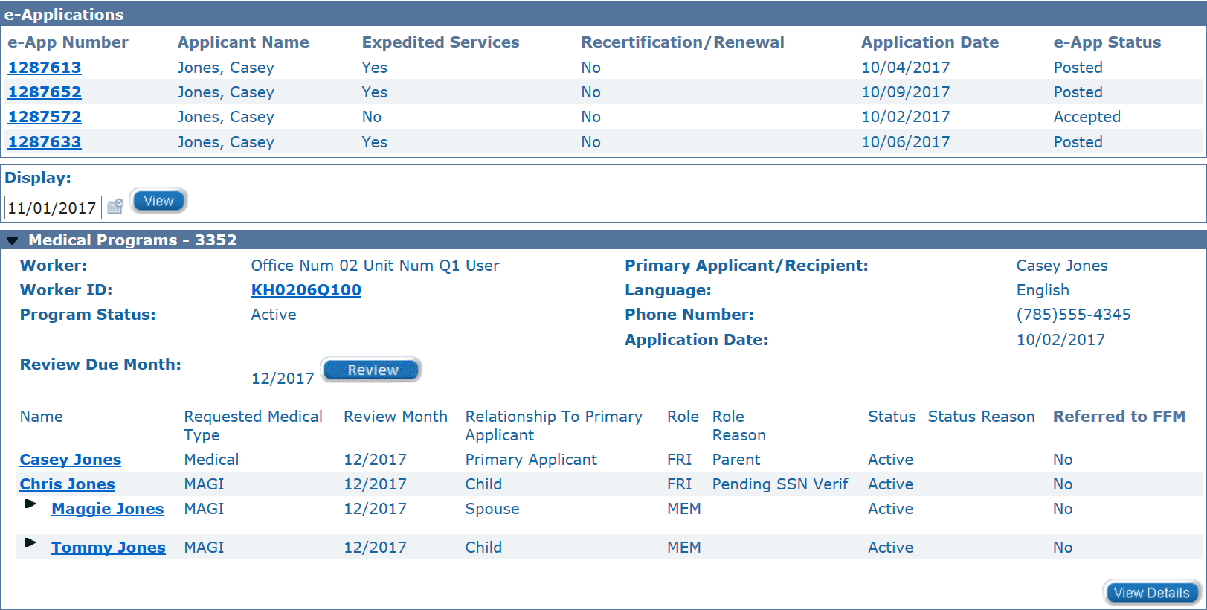
Notes:
(Interactive Question)
We are going to show some program blocks with clients that are either receiving assistance, in a pending status, or denied. You need to decided whether the e-Applications are in the appropriate status based on the program block and the definitions provide earlier in the training.
If you guessed that the e-Applications are in the right status then you are correct.
The members are all in an active status and their e-Applications are all in either a Posted or Accepted status.

Slide 10
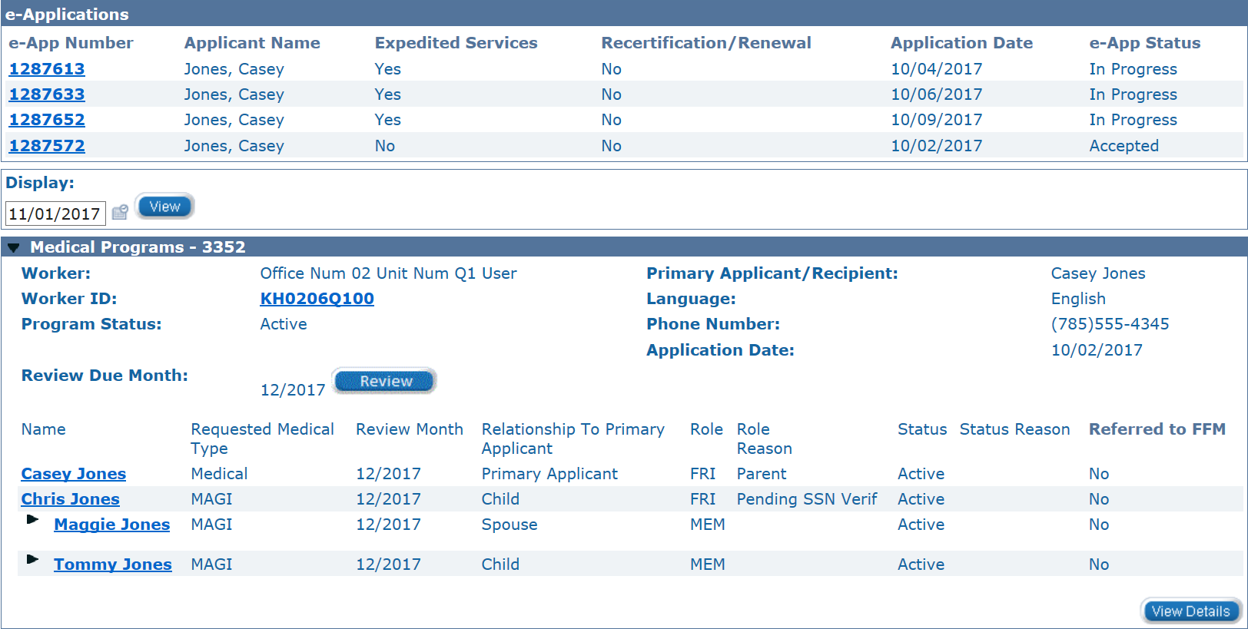
Notes:
(Interactive Question)
Are the e-Applications in the correct status?
If you guessed the e-Applications are in the wrong status then you are correct.
All members are in an Active status so their e-applications should all be in a Posted or Accepted status. In this scenario an Eligibility worker would need to manually update the e-Application status.

Slide 11
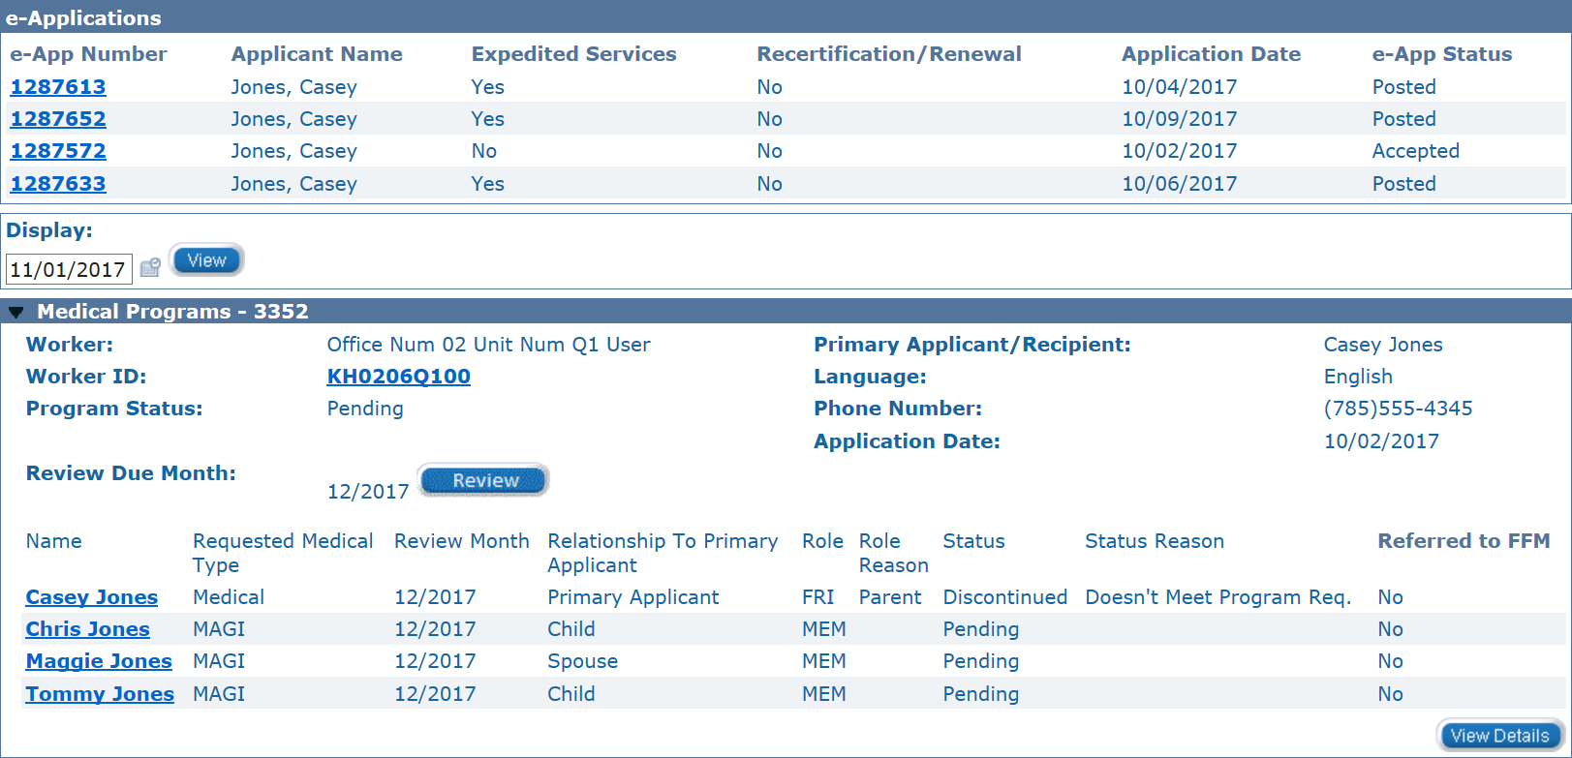
Notes:
(Interactive Question)
Are the e-Applications in the correct status?
If you guessed the e-Applications are in the wrong status then you are correct.
The EDBC still needs to be ran on this case; however, the e-Applications have all been updated to a Posted status. E-Applications should only be updated after EDBC has been ran and saved.

Slide 12
Registering Multiple e-Applications
The process for registering a case will be more consistent, all additional e-Applications will be linked.
After the first e-Application is linked to a case, registration workers will need to manually assign the Ghost Worker ID to any additional e-Applications that are linked.
Manually indexing images will no longer be the part of the normal process.
Notes:
Registration will only need to find the useable case and determine if the case is a duplicate application. If the application is not a duplicate application then they can follow the regular e-Summary registration process as normal. This will prevent registration from having to manually index images, if all images are automatically linked correctly.
There will be one difference in the registration process and that will be the manual assignment of the Ghost worker ID. We’ll take a look steps of this process and when it will occur.
Registration will be more consistent, because the only e-Apps that are not linked will be exact duplicates.
When e-linking an e-App, worker will be navigated to the e-App Summary instead of the case summary.
Since the e-linking process will end on e-App Summary, the flow of registration work will not be disrupted by the manual worker assignment.
The consistent e-linking will retire the need to manually index images.

Slide 13
Manually Assigning a Worker ID
To get an e-App out of Pending status after it has been linked to a case.
Click the Edit button on the e-App Summary.
Locate the Assigned Worker Info section at the button of the page.
Enter the Ghost Worker ID in the Worker ID field in the Assigned Worker Info section.
Once a Worker ID is entered, Click Save.
The e-App Summary page will redisplay with the e-App now in an In Progress status.
Let’s take a look at what this looks like.
Notes:
Manually assigning the Ghost Worker ID is required when the Worker Assignment page is skipped during the e-Summary registration process. This occurs when linking a multiple application because a worker ID is already assigned to the program block. When the Worker Assignment page is skipped, the e-Summary registration process will not navigate the registration worker to the Case summary. Instead the registration worker will be navigated to the e-Application Summary. The worker can then follow the steps on this slide to complete the Worker ID assignment.
Last part of linking process, before registration clean up.
Worker Assignment page will have been skipped.
Instead registration worker will be navigated to the e-App Summary to assign Worker ID.
e-App will be linked when ending on the e-App summary; however, will still be in pending.
All registered e-Apps must be in In Progress status before registration is complete.
If this is not done, e-App will continue to show up on Registration reports.
Lets take a look at what this looks like in the system.

Slide 14
1. Click the Edit button on the e-App Summary.
2. Locate the Assigned Worker Info section at the button of the page.
3. Enter the Ghost Worker ID in the Worker ID field in the Assigned Worker Info section.
Notes:
(Read the steps)

Slide 15
4. Once a Worker ID is entered, Click Save
5. The e-App Summary page will redisplay with the e-App now in an In Progress status.
Notes:
(Read steps)

Slide 16
Manually Updating an In Progress e-App status
To manually update an e-App’s status.
Locate the In Progress e-App on the case summary and click on the e-App number.
Click “Edit” on the e-App Summary.
At the top of the e-App Summary there is a dropdown.
When in an In Progress status the options in this dropdown will be Posted and Not Accepted. Unless it was determined that an application was a duplicate use Posted.
Once a value has been selected in the dropdown, click the “Save” button.
Let’s take a look at what this looks like.
Notes:
This must be done on all multiple applications by Eligibility after EDBC is ran because EDBC only updates one e-Application to Accepted. This is a quick and simple process.
Anytime there are multiple e-Applications.
Done after EDBC is ran, accepted, and saved.
If not done, a case will continue to show up on Eligibility reports.

Slide 17
Locate the In Progress e-App on the case summary and click on the e-App number.
Select a value of Posted and click the Save button.
Notes:
(Read steps)

Slide 18
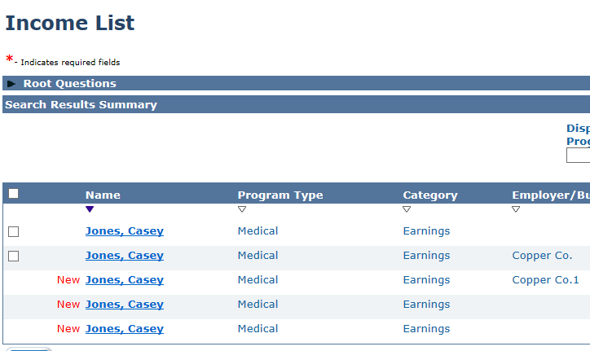
Data Acceptance
We have always been required to review all applications received. All records will now be represented in the system.
This doesn’t change what information we want in the system. We should only be accepting current income, addresses, resources, etc.
There is a difference between list pages and single record pages such as Individual Demographics.
Notes:
Keep in mind the application that will be creating some additional Data Acceptance have always needed to be reviewed by staff. Their information is now just represented in the system.
The same rules apply regarding data acceptance. We should not accept multiple records if they are the same. If an applicant were to report the same earnings three times then a worker can reject two records and accept one.
List pages will create a list of records to accept or reject. Single record pages such as Individual Demographics will only have one record with a NEW indicator. Staff will need to click edit on each individual multiple times. Once data acceptance on the Individual Demographics page is complete for an individual, the NEW indicator will disappear.
Always been required to review all valid applications.
We must ensure we are only accepting records that will be used in the determination.
Don’t accept an address if it is not most current
Workers can see exactly how many Data Acceptance records are on List Pages.
Single record pages have the Data Acceptance records behind the seen by person.

Slide 19
Data Acceptance Tips and Tricks
With multiple e-Applications being linked there will be an increase in the number of data acceptance records. To help with that, we have collected some helpful tips to getting through these records after.
Notes:
(Read Slide)
We will show you two tips for the Contact Page and one for Individual Demographics.
Although Data Acceptance has been improved, some pages still troublesome.
A few tricks to make Data Acceptance faster.

Slide 20
Contact Page
This page can be a mess with multiple e-Applications but luckily it can also be the fastest page to clean up with two helpful tricks.
Rejecting all Data Acceptance records from all e-Applications at once.
Accepting the whole household’s address records at once.
Notes:
The Contact Page creates two records per person, Mailing and Physical, per application. These records can quickly add up on the Contact page.
Show two tricks for this page:
A worker can actually reject all Data Acceptance records from all e-Applications on the Contact page at once.
All Data Acceptance records from one e-Application can also be accepted for all household members at once.

Slide 21
Rejecting all Contact Records
Notes:
This is the fastest way to clean up the Contact page.

Slide 22
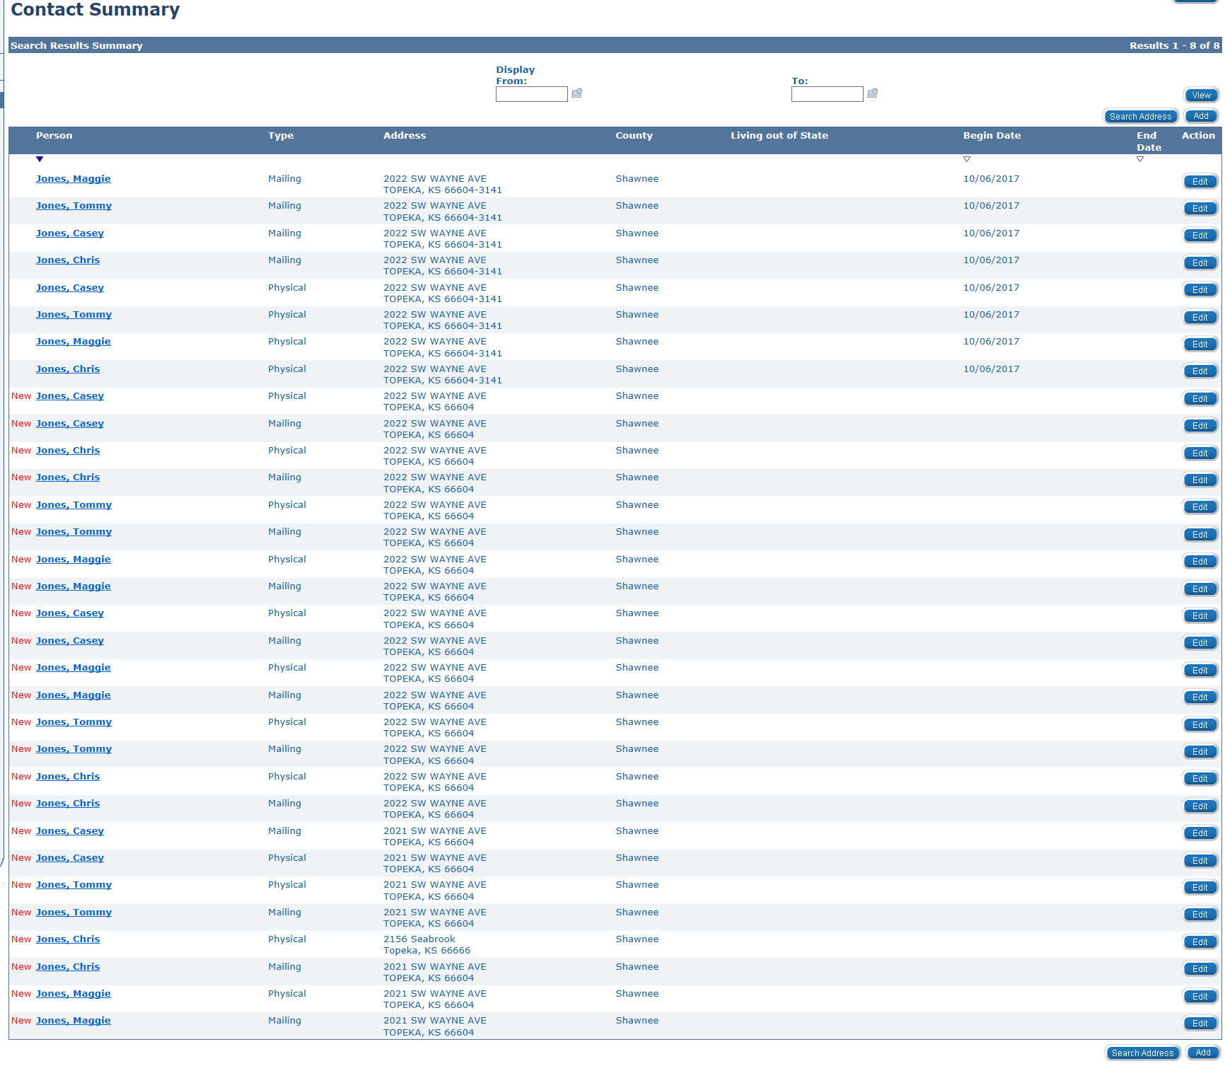
Notes:
In a scenario where the same address has been reported over multiple e-Applications the Contact List can be intimidating; not to mention quite time-consuming if the a worker attempted to reject the records one at a time. In these situations staff can reject all of the records at once. This could save valuable minutes of processing time. This can also be used when multiple applications have reported different addresses and only the most recent address is needing to be added to the system. Start with selecting edit on just one of the “new” records.
Address already in system but created again for each app.
Don’t need to accept New records if the address isn’t actually new.

Slide 23
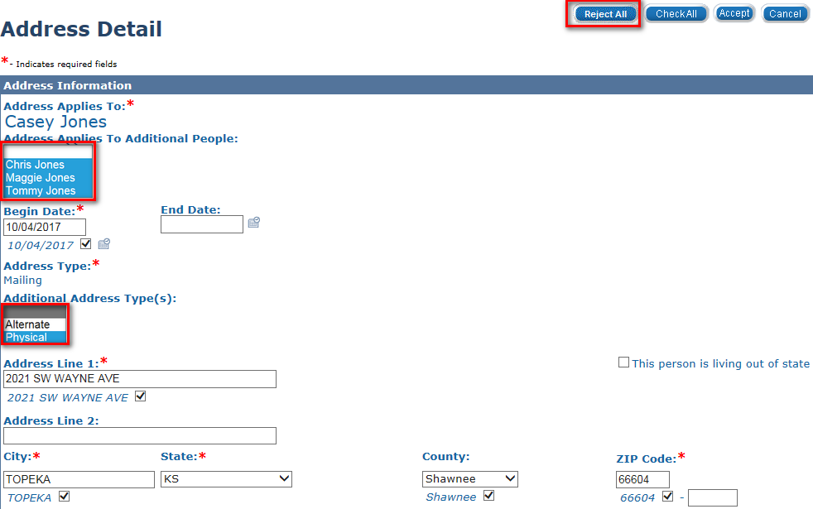
Notes:
Once in the detail, hold the Ctrl key and select all of the case members and once again use the Ctrl key to select the other Address Type. That could be either Physical or Mailing, depending on what record you initially selected. Once all case members and address types have been highlighted, click the Reject All button at the top right of the detail page.
Use Ctrl to select all HH members and other address type.
Click reject all.

Slide 24
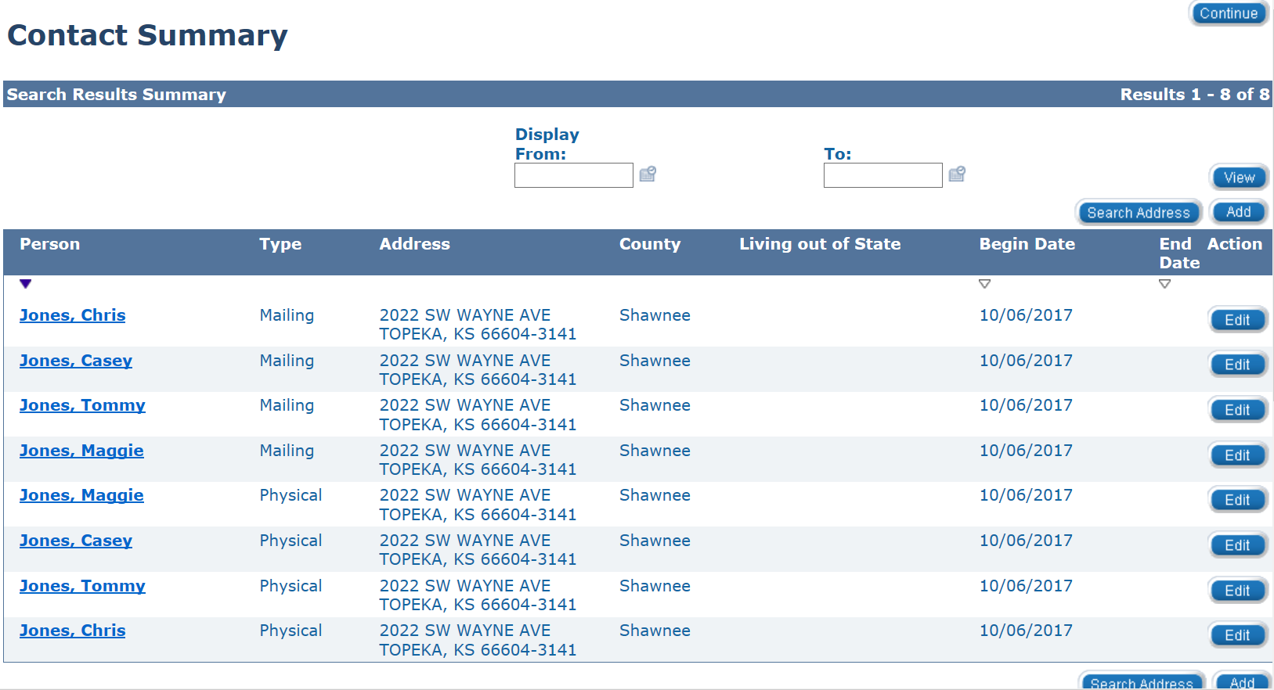
Notes:
The Reject All button will navigate the worker back to the Contact Summary page. The page will now no longer have any data acceptance records.

Slide 25
Accepting all Contact Records from one e-Application
Notes:
This can be used when there is only one e-Application or when there are Multiple e-Applications.

Slide 26
Notes:
In a scenario where a new address is reported, a worker is able to Data Accept a new address record for all household members at once. It is similar to the previous trick; however, we are only able to do one e-Application’s Data Acceptance records at a time. Although this is preferred because only one e-Application’s address needs to be accepted. Start by selecting by selecting Edit on one data acceptance record.
One or more New records are actually new address(es)
Click edit on one of the New records with the correct new address records

Slide 27
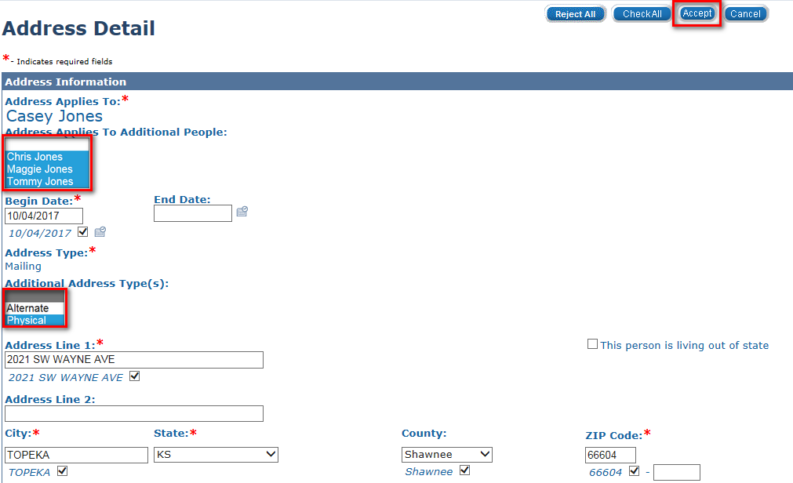
Notes:
Once in the detail, hold the Ctrl key and select all of the case members that are in the home and once again use the Ctrl key to select the other Address Type. That could be either Physical or Mailing, depending on what record you initially selected. Once all case members and address types have been highlighted, click the Accept button at the top right of the detail page.
It is important to only be selecting members who are in the home when doing this trick. You cannot update anyone’s address who is not in the home.
Use Ctrl to select ONLY members who are in the household and other address type, if applicable.
Enter date that address is being added to the system.
Click Accept

Slide 28
Notes:
The worker will be navigated back to the Contact List. All records from one e-Application have now been accepted. The remaining Data Acceptance records can now be rejected.
The remaining records can now be rejected using the first trick.

Slide 29
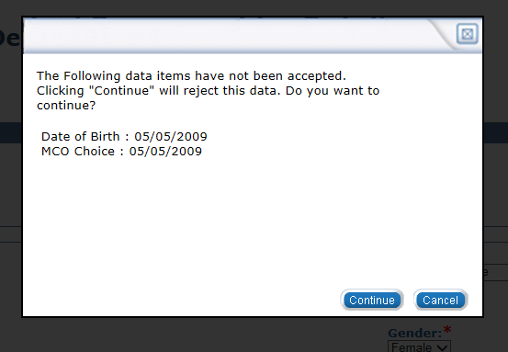
Previewing Data Acceptance
On the Individual Demographics page, when a worker hits Accept there will be a window that pops up if any data has not been accepted.
Notes:
The last tip we will show you is how to get a list to preview of all Data Acceptance records on the Individual Demographics page. If a worker clicks the Accept button when first opening the page, it will actually give a list of all the areas that have a Data Acceptance record. Then a worker can Cancel out to accept the necessary information. Due do the fields on this page not typically being subject to change, there will typically be little difference from one application or another. Therefore, this can be helpful to prevent a worker from searching the page only to find there is no information that needs to be accepted. Things to look for are changes to the MCO request and the phone number. These are the most frequently updated fields.
The Ind. Dem. Page has a large number of fields and the records can be hard to find.
To get a list of all New info, a worker can click accept when page is first opened.
Worker can then decided is info is actually new or not.
MCO request and phone number are areas that can frequently change in a short time.
Don’t update SSN or DOB without researching.

Slide 30
References
Data Acceptance Processing Guide
Multiple e-App Process – Quick Reference Guide
KEES Repository: Home > KEES User Manual Introduction > e-Applications > Manually Updating e-Application Status
Notes:
These job aids and guides contain information that would be helpful while processing any application but may be especially helpful when there are multiple e-Applications linked.

Slide 31
www.kancare.ks.gov
Any Additional Questions?

